Slide 1

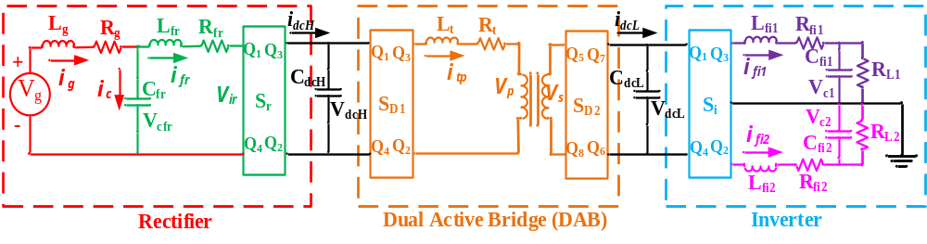


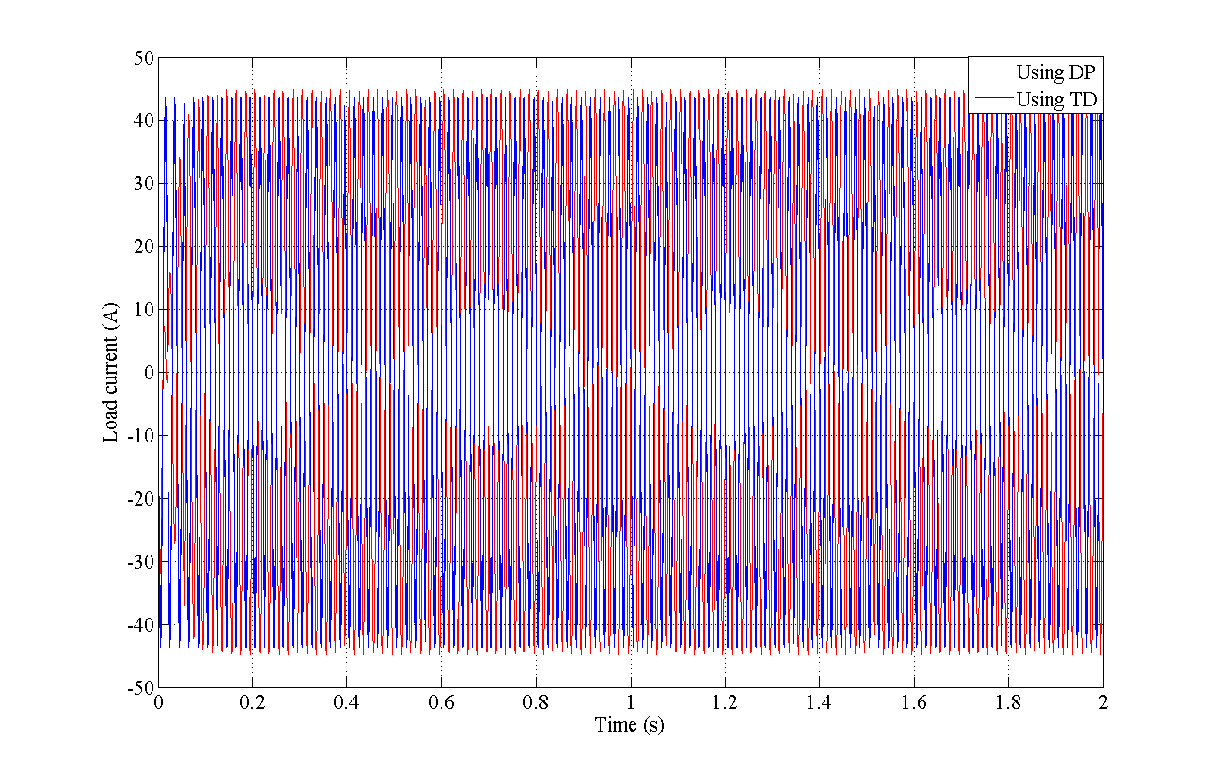
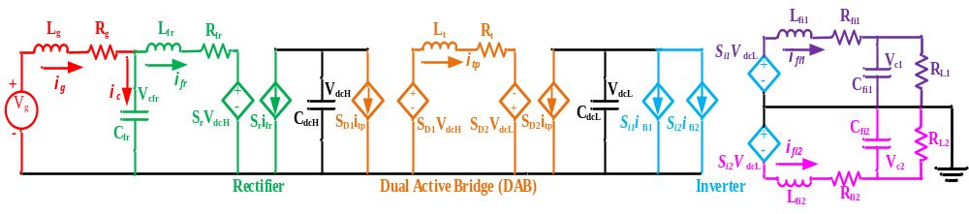
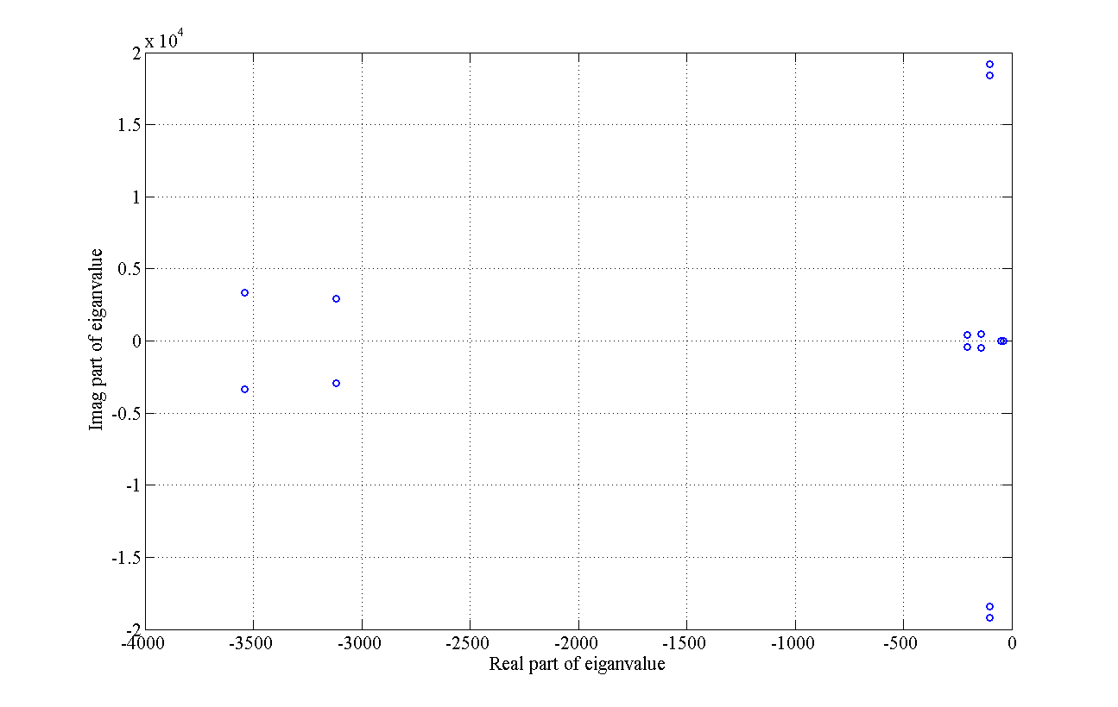
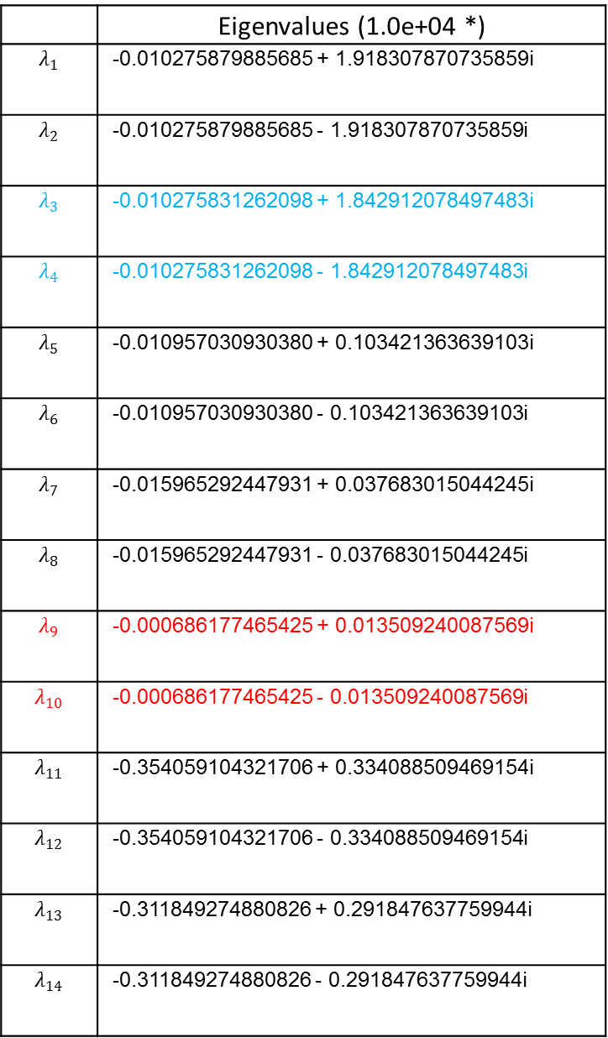
Y7.FS2 System Theory, Modeling and Controls
Dynamic phasor-based model for solid state transformer
S.R.Wagh and A. Stankovic, Tufts University
Dynamic phasor model of the Solid State Transformer (SST)
where,
X- State variables
U- Switching functions, controls
Fig. 1 Schematic representation of Solid state transformer (SST)
Dynamic phasor modeling
Averaged circuit representation
where,
ΔX_{SST} – System state variables
Δd_{SST} – (Duty cycle) control variables
ΔU_{SST} – input variables
Fig. 2 Average circuit model for Solid state transformer (SST)
Fig. 3 Load current at inverter output using Time domain (TD) and Dynamic phasors (DP)
Small-signal average model (SSAM) for SST
Table 1. Eigenvalue for SST DP based small-signal average model
 | Eigenvalues (1.0e+04 *)
 | -102.8 + j19,183.1
 | -0.010275879885685 - 1.918307870735859i
 | -0.010275831262098 + 1.842912078497483i
 | -0.010275831262098 - 1.842912078497483i
 | -0.010957030930380 + 0.103421363639103i
 | -0.010957030930380 - 0.103421363639103i
 | -0.015965292447931 + 0.037683015044245i
 | -0.015965292447931 - 0.037683015044245i
 | -0.000686177465425 + 0.013509240087569i
 | -0.000686177465425 - 0.013509240087569i
 | -0.354059104321706 + 0.334088509469154i
 | -0.354059104321706 - 0.334088509469154i
 | -0.311849274880826 + 0.291847637759944i
 | -0.311849274880826 - 0.291847637759944i
Fig. 5 Eigenvalue plot for SST DP based small-signal average model
Fig. 4 Matrix representation for SST DP SSAM including circuit loading
Stability analysis and control
Table 2. Participation factors for key eigenvalues
Considering the original nonlinear structure of the dynamic model, a nonlinear controller could be devised,
Using the derived SSAM, it is proposed to develop linear controller such as Model predictive controller (MPC),
Stability analysis for various renewable sources integrated with grid through SST can be studied from real-time applications point of view,
The issue of synchronization and voltage stability can be studied in detail and necessary control strategy can be developed for enhancement of overall system.
 | Lambda 9 (-7+135) | Lambda 3 (-103+j18,429)
X1 | 0 | 0.1039 + 0.0003i
X2 | 0 | 0.1039 - 0.0003i
X3 | 0 | -0.1041 - 0.0006i
X4 | 0 | -0.1041 + 0.0006i
X5 | -0.4637 -0.0493i | -0.0014 - 0.0062i
X6 | -0.4637 +0.0493i | -0.0014 + 0.0062i
X7 | 0.0226 + 0.0265i | -0.2745 + 0.0213i
X8 | 0.0226 - 0.0265i | -0.2745 - 0.0213i
X9 | 0.0026 + 0.0016i | -0.0133 - 0.0023i
X10 | 0.0026 - 0.0016i | -0.0133 + 0.0023i
X11 | 0 | 0
X12 | 0 | 0
X13 | 0 | 0
X14 | 0 | 0
Complement:
Time-domain simulations by offering sensitivities to design quantities and basis for control design,
Robust control design methods by exploiting simplicity of energy flow and dissipation as a basis for effective design,
Port-controlled Hamiltonian descriptions with hierarchical, multi-scale modeling at different levels of abstraction.
Key properties:
Large signal, time-invariant,
Slow variation of inputs,
Simultaneous demodulation – PI
Revealing couplings,
Refinements and simplifications,
Modularity,
Multi-scale – phasor banks.

